Slide 1
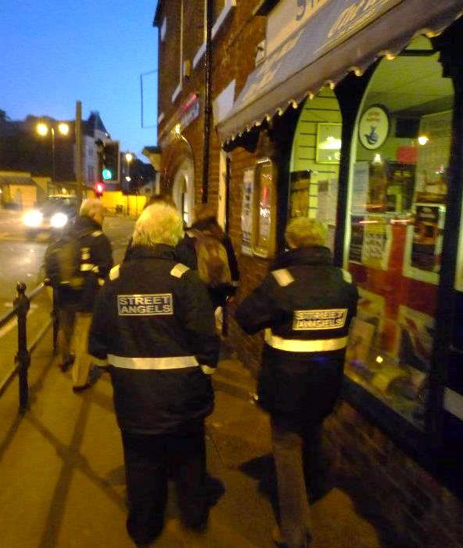
Street Angels
Whitby
We are a force for good in the weekend night-time economy, helping to safeguard people.
We are volunteers and work alongside the police and pub/club door staff, linked to town centre CCTV.
We are there to be a reassuring presence; to care, to listen, to talk and to offer practical help to anyone who may be vulnerable.
www.street-angels.org.uk
A mobile night time presence
looking out for people
"Dude with Wings" design and text © copyright Charisma Art Ltd. Used with permission

Slide 2
What? We respond when someone needs help, and call the appropriate services if needed. However, we hope to reduce these calls by helping practically: sweeping up glass, assisting people to get home, talking with people and providing flip-flops and water when needed. We aim to be friendly faces in Whitby, helping people have fun and to stay safe. We have no special powers, but are willing to go out of our way to do good service without fear or favour.
When? 10pm – 2am every Friday and occasional other weekend nights. We are planning to extend to Saturdays too.
Where? Central Whitby and the edges of the town centre to start with but as outlying pubs close, focused more centrally.
Who? Anyone over 18. Volunteers need references and checks and must undergo training . Most Street Angels are Christians but you don’t have to be – just wanting to be part of a team looking out for people in the night-time economy. We value greatly all our prayer supporters.
More info and giving: www.street-angels.org.uk
Street Angels
Whitby

